Slide 1
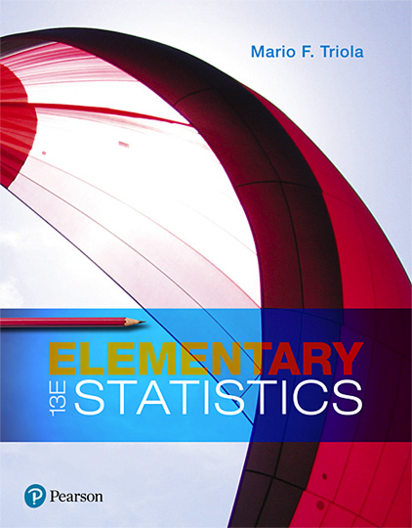
Elementary Statistics
Thirteenth Edition
Chapter 9
Inferences from Two Samples
Copyright © 2018, 2014, 2012 Pearson Education, Inc. All Rights Reserved

Slide 2
Inferences from Two Samples
9-1 Two Proportions
9-2 Two Means: Independent Samples
9-3 Two Dependent Samples (Matched Pairs)
9-4 Two Variances or Standard Deviations

Slide 3
Key Concept
This section presents methods for using sample data from two independent samples to test hypotheses made about two population means or to construct confidence interval estimates of the difference between two population means.

Slide 4
Independent (1 of 2)
Independent
Two samples are independent if the sample values from one population are not related to or somehow naturally paired or matched with the sample values from the other population.

Slide 5
Independent (2 of 2)
Dependent
Two samples are dependent (or consist of matched pairs) if the sample values are somehow matched, where the matching is based on some inherent relationship.

Slide 6
Inferences About Two Means: Independent Samples: Objectives
Objectives
​​Hypothesis Test: Conduct a hypothesis test of a claim about two independent population means.
​​Confidence Interval: Construct a confidence interval estimate of the difference between two independent population means.

Slide 7
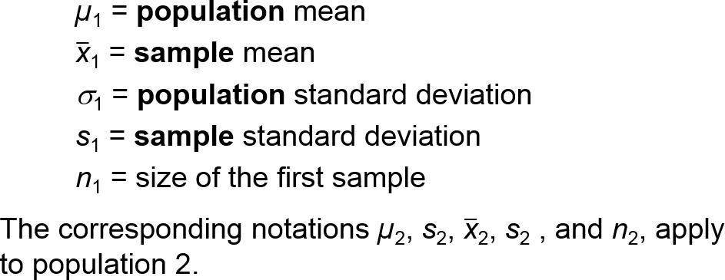
Inferences About Two Means: Independent Samples: Notation
Notation
For population 1 we let

Slide 8
Inferences About Two Means: Independent Samples: Requirements
Requirements
The values of σ₁ and σ₂ are unknown and we do not assume that they are equal.
The two samples are independent.
Both samples are simple random samples.
Either or both of these conditions are satisfied: The two sample sizes are both large (with n₁ > 30 and n₂ > 30) or both samples come from populations having normal distributions.

Slide 9
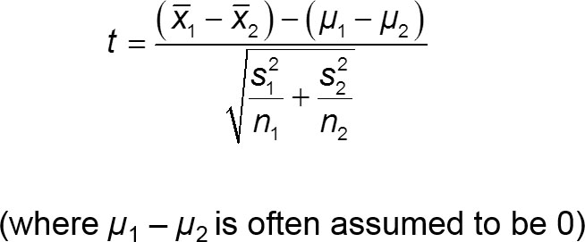
Inferences About Two Means: Independent Samples: Hypothesis Test Statistic for Two Means: Independent Samples (with H₀: µ₁ = µ₂) (1 of 3)

Slide 10
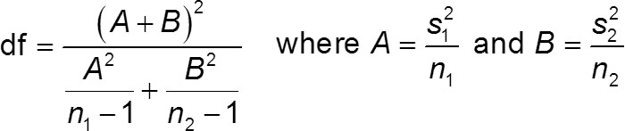
Inferences About Two Means: Independent Samples: Hypothesis Test Statistic for Two Means: Independent Samples (with H₀: µ₁ = µ₂) (2 of 3)
Degrees of freedom
Use this simple and conservative estimate: df = smaller of n₁ − 1 and n₂ − 1.
Technologies typically use the more accurate but more difficult estimate given by the following formula:

Slide 11
Inferences About Two Means: Independent Samples: Hypothesis Test Statistic for Two Means: Independent Samples (with H₀: µ₁ = µ₂) (3 of 3)
P-Values: P-values are automatically provided by technology. If technology is not available, refer to the t distribution in Table A-3. Critical Values: Refer to the t distribution in Table A-3.

Slide 12
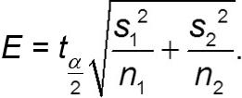
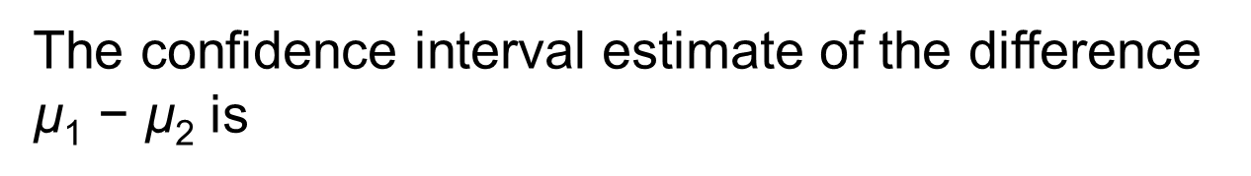
Inferences About Two Means: Independent Samples: Confidence Interval Estimate of µ₁ – µ₂ : Independent Samples
The confidence interval estimate of the difference $\text{µ}$₁ − $\text{µ}$₂ is
where the margin of error E is given by

Slide 13
Example: Are Male Professors and Female Professors Rated Differently by Students? (1 of 10)
Listed below are student course evaluation scores for courses taught by female professors and male professors. Use a 0.05 significance level to test the claim that the two samples are from populations with the same mean. Does there appear to be a difference in evaluation scores of courses taught by female professors and male professors?
Female | 4.3 | 4.3 | 4.4 | 4.0 | 3.4 | 4.7 | 2.9 | 4.0 | 4.3 | 3.4 | 3.4 | 3.3 | blank | Blank | blank
Male | 4.5 | 3.7 | 4.2 | 3.9 | 3.1 | 4.0 | 3.8 | 3.4 | 4.5 | 3.8 | 4.3 | 4.4 | 4.1 | 4.2 | 4.0

Slide 14
Example: Are Male Professors and Female Professors Rated Differently by Students? (2 of 10)
Solution
Requirement Check (1) The values of the two population standard deviations are not known and we are not making an assumption that they are equal. (2) The two samples are independent because the female professors and male professors are not matched or paired in any way.

Slide 15
Example: Are Male Professors and Female Professors Rated Differently by Students? (3 of 10)
Solution
Requirement Check (3) The samples are simple random samples. (4) Both samples are small (30 or fewer), so we need to determine whether both samples come from populations having normal distributions. Normal quantile plots of the two samples suggest that the samples are from populations having distributions that are not far from normal.
The requirements are all satisfied.

Slide 16
Example: Are Male Professors and Female Professors Rated Differently by Students? (4 of 10)
Solution
Step 1: The claim that “the two samples are from populations with the same mean” can be expressed as µ₁ = µ₂.
Step 2: If the original claim is false, then µ₁ ≠ µ₂.
Step 3: The alternative hypothesis is the expression not containing equality, and the null hypothesis is an expression of equality, so we have
H₀: µ₁ = µ₂ H₁: µ₁ ≠ µ₂

Slide 17
Example: Are Male Professors and Female Professors Rated Differently by Students? (5 of 10)
Solution
We now proceed with the assumption that µ₁ = µ₂, or µ₁ − µ₂ = 0.
Step 4: The significance level is α = 0.05.
Step 5: Because we have two independent samples and we are testing a claim about the two population means, we use a t distribution with the test statistic given earlier in this section.

Slide 18
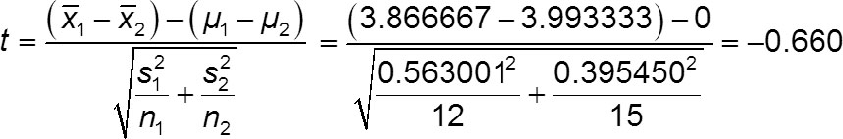
Example: Are Male Professors and Female Professors Rated Differently by Students? (6 of 10)
Solution
Step 6: The test statistic is calculated using these statistics (with extra decimal places) obtained from the listed sample data:

Slide 19
Example: Are Male Professors and Female Professors Rated Differently by Students? (7 of 10)
Solution
P-Value With test statistic t = −0.660, we refer to Table A-3 (t Distribution). The number of degrees of freedom is the smaller of n₁ − 1 and n₂ − 1, or the smaller of (12 − 1) and (15 − 1), which is 11. With df = 11 and a two-tailed test, Table A-3 indicates that the P-value is greater than 0.20. Technology will provide the P-value of 0.5172 when using the original data or unrounded sample statistics.

Slide 20
Example: Are Male Professors and Female Professors Rated Differently by Students? (8 of 10)
Solution
Step 7: Because the P-value is greater than the significance level of 0.05, we fail to reject the null hypothesis. (“If the P is low, the null must go.”)

Slide 21
Example: Are Male Professors and Female Professors Rated Differently by Students? (9 of 10)
Interpretation
Step 8: There is not sufficient evidence to warrant rejection of the claim that female professors and male professors have the same mean course evaluation score.

Slide 22
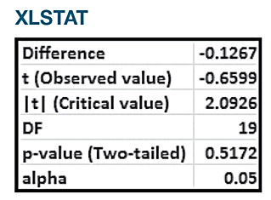
Example: Are Male Professors and Female Professors Rated Differently by Students? (10 of 10)
Technology
The tricky part about the preceding P-value approach is that Table A-3 can give only a range for the P-value, and determining that range is often somewhat difficult. Technology automatically provides the P-value, so technology makes the P-value method quite easy. See the accompanying XLSTAT display showing the test statistic of t = −0.660 (rounded) and the P-value of 0.5172.

Slide 23
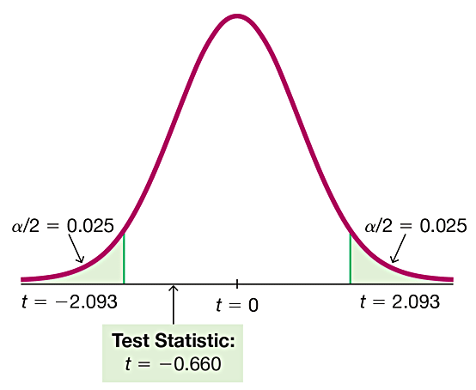
Critical Value Method
The critical value method of testing a claim about two means is generally easier than the P-value method. With n₁ = 12 and n₂ = 15, the number of degrees of freedom is 11. In Table A-3 with df = 11 and α = 0.05 in two tails, we get critical values of t = ±2.201. Technology provides t = ±2.093.
The test statistic of t = −0.660 falls between the critical values, so the test statistic is not in the critical region and we fail to reject the null hypothesis.

Slide 24
Example: Confidence Interval for Female and Male Course Evaluation Scores (1 of 5)
Using the previous data, construct a 95% confidence interval estimate of the difference between the mean course evaluation score for female professors and the mean course evaluation score for male professors.

Slide 25
Example: Confidence Interval for Female and Male Course Evaluation Scores (2 of 5)
Solution
Requirement check
Because we are using the same data from the previous example, the same requirement check applies here, so the requirements are satisfied.

Slide 26
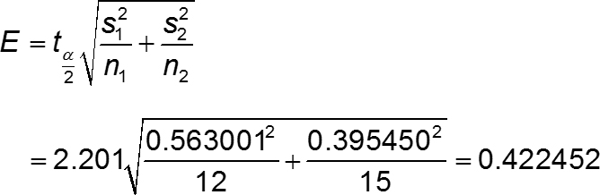
Example: Confidence Interval for Female and Male Course Evaluation Scores (3 of 5)
Solution
We first find the value of the margin of error E. In Table A-3 with df = 11 and α = 0.05 in two tails, we get critical values of t = ± 2.201. (Technology can be used to find more accurate critical values of t = ± 2.093.

Slide 27
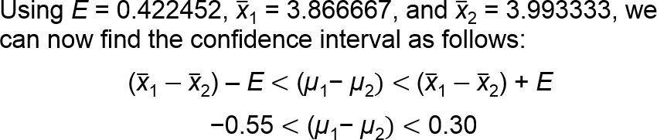
Example: Confidence Interval for Female and Male Course Evaluation Scores (4 of 5)
Solution
If we use technology to obtain more accurate results, we get the confidence interval of −0.53 < (µ₁ − µ₂) < 0.27, so we can see that the confidence interval above is quite good.

Slide 28
Example: Confidence Interval for Female and Male Course Evaluation Scores (5 of 5)
Interpretation
We are 95% confident that the limits of −0.53 and 0.27 actually do contain the difference between the two population means. Because those limits contain 0, this confidence interval suggests that there is not a significant difference between the mean course evaluation score for female professors and the mean course evaluation score for male professors.

Slide 29
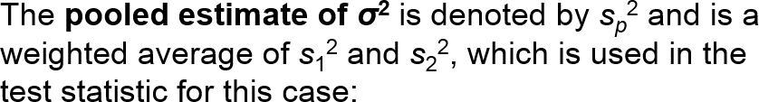
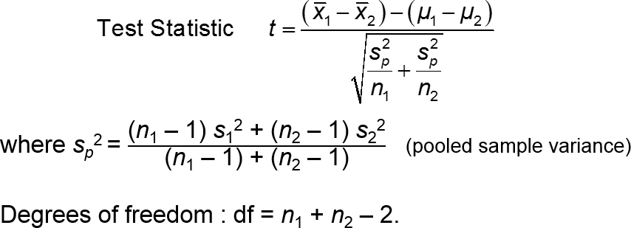
Alternate Methods: Assume that σ₁ = σ ₂ and Pool the Sample Variances (1 of 2)

Slide 30
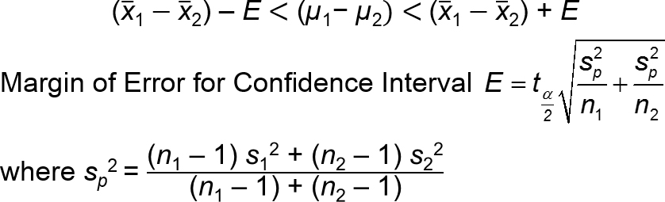
Alternate Methods: Assume that σ₁ = σ ₂ and Pool the Sample Variances (2 of 2)
Confidence interval are found by evaluating
Degrees of freedom : df = n₁ + n₂ − 2.

Slide 31
Alternate Methods: Assume When σ₁ and σ₂ Are Known (1 of 2)
In reality, the population standard deviations s₁ and s₂ are almost never known, but if they are somehow known, the test statistic and confidence interval are based on the normal distribution instead of the t distribution.

Slide 32
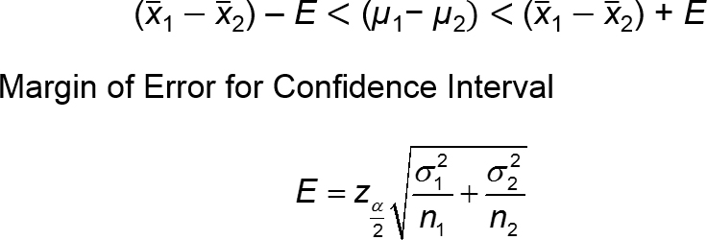
Alternate Methods: Assume When σ₁ and σ₂ Are Known (2 of 2)
Confidence interval are found by evaluating

Slide 33
Recommended Strategy for Two Independent Means
Here is the recommended strategy for the methods of this section:
Assume that s₁ and s₂ are unknown, do not assume that s₁ = s₂, and use the test statistic and confidence interval given in Part 1 of this section.

